Slide 1


Progress on Network Representation Learning and Future Directions
Jian Tang
HEC Montréal
Montréal Institute of Learning Algorithms (MILA)
tangjianpku@gmail.com

Slide 2
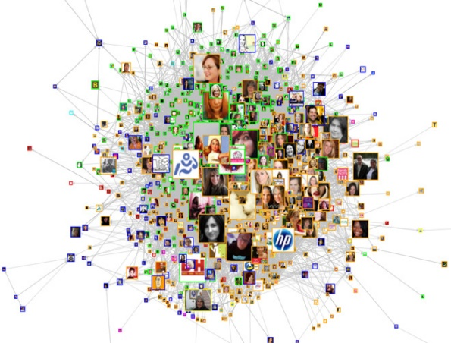
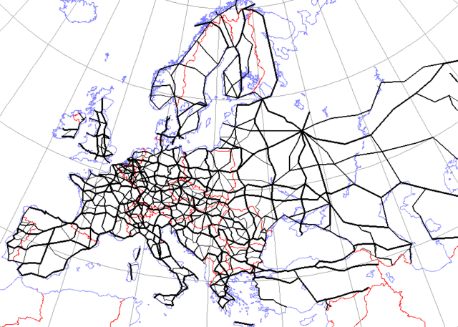
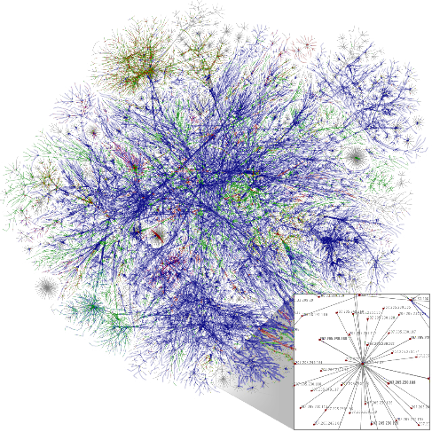
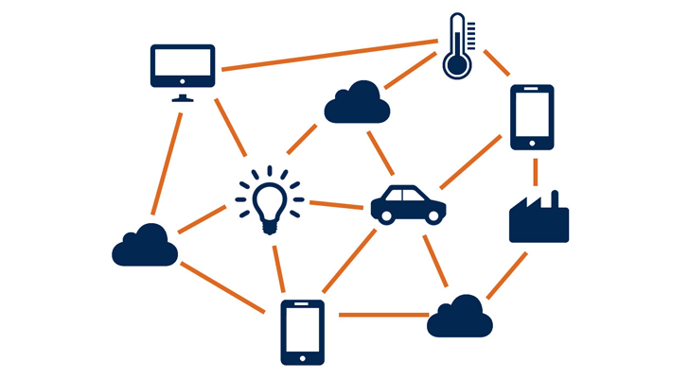
Networks
Ubiquitous in real world
Social Network
Road Network
World Wide Web
Internet-of-Things
A flexible and general data structure
  Many types of data can be formulated as networks
Notes:
Let’s start by introducing the motivation of studying networks. Networks encode relationships between different objects and are ubiquitous in real world. For example, social networks encode the social relationship between users; citation networks encode the citing relationship between papers; the World Wide Web represents the hyperlink between Webpages. In the future, everything will be connected, which is known as Internet-of-Things. Besides, network is a very flexible and general data structure, and many data can be reformulated as networks. Therefore, if we
can solve problems on networks, many problems on other data can be solved as well.

Slide 3
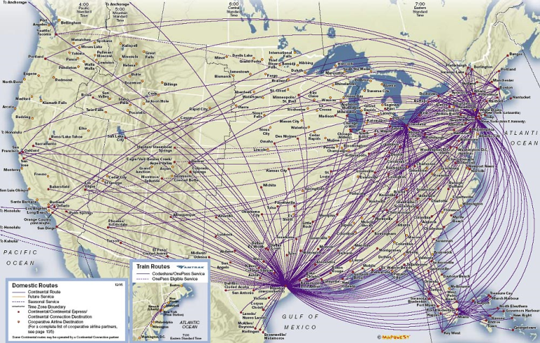
Continental Airline: Source: http://www.airlineroutemaps.com/

Slide 4
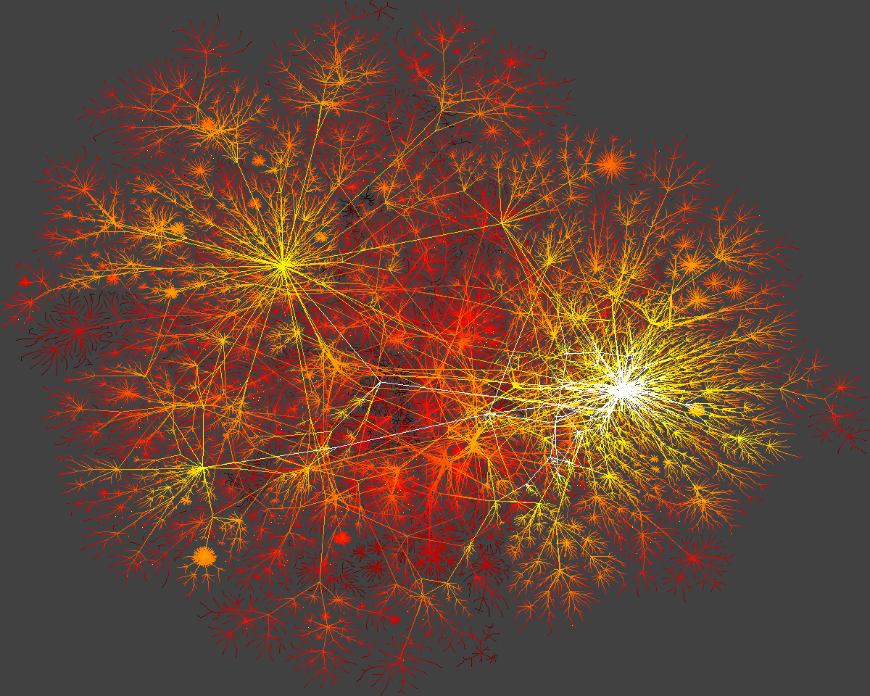
Graph from Albert-László Barabási’ s SIGIR09 keynote

Slide 5
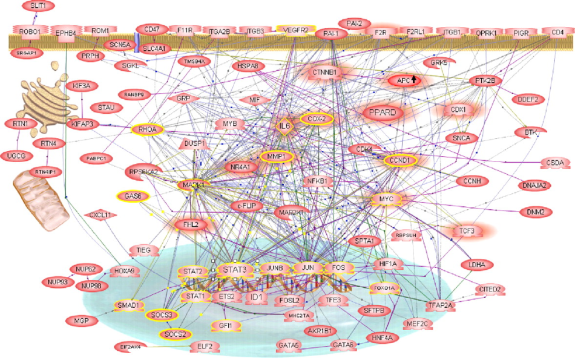
- Abdollahi et al. Transcriptional network governing the angiogenic switch in human pancreatic cancer. PNAS vol. 104 no. 31,2007
Gene-Regulatory Network

Slide 6
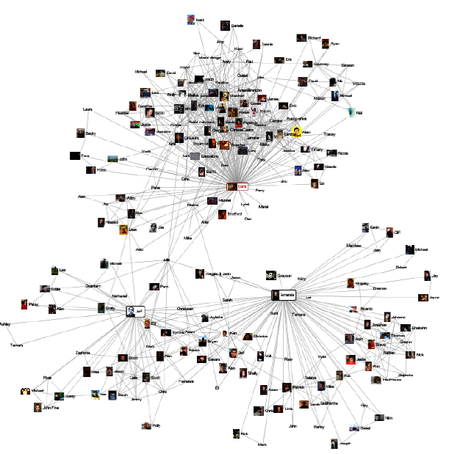

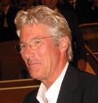
Network Mining: Link Prediction
Does she know
Richard Gere?

Slide 7
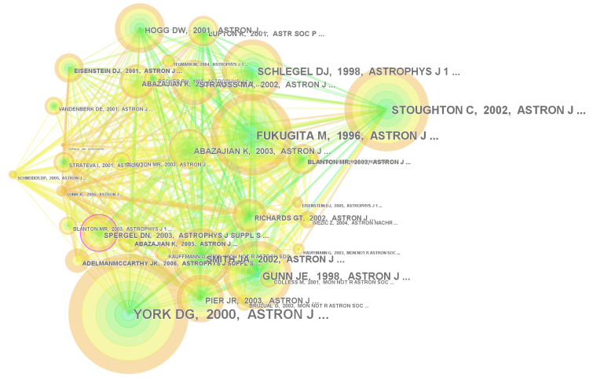
Network Mining: Ranking
Importance of vertices
Which is the most influential paper?
Co-citation network of Sloan Digital Sky Survey
- http://nevac.ischool.drexel.edu/~james/infovis09/FP-tree-visual.html

Slide 8
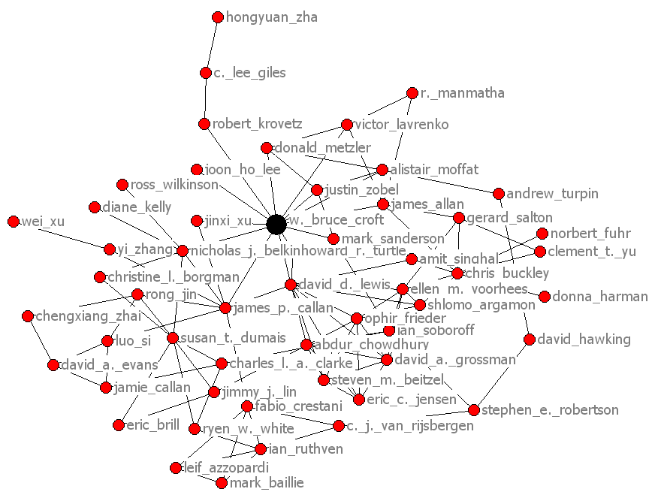
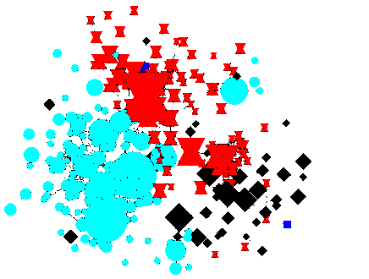
Network Mining: Community Detection
Coauthor Network
Information retrieval
Machine learning
Data mining
Who tend to work together?
- Q.Mei, D.Cai, D.Zhang, and C.Zhai, Topic Modeling with Network Regularization, WWW 2008

Slide 9
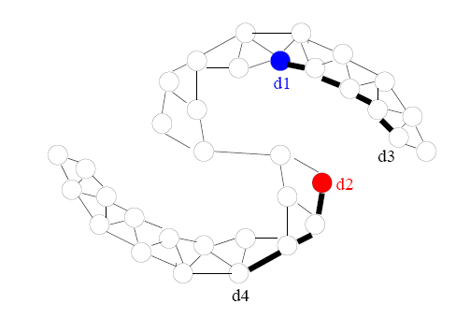
Network Mining: Classification
d1 is democratic
d2 is republican
What can we say about d3 and d4?
- Graph from Jerry Zhu’s tutorial in ICML 07
Notes:
Demo’cratic

Slide 10
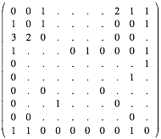
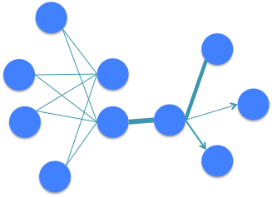
Traditional Representations of Networks
Suffer from data sparsity
Suffer from high dimensionality
Does not facilitate computation
Does not represent “semantics”
…
Notes:
To analyze networks, the first step is to effectively represent networks, which largely determine the performance of many follow up tasks on networks. You may think this is very easy by simply representing networks as adjacency matrices. However, this type of representations suffers from serious problem of data sparsity and high-dimensionality, which does not facility computation for network analysis. Meanwhile, it do not represent any semantics, making it difficult to understand networks.

Slide 11
Research Questions and Challenges
How to effectively and efficiently represent a Large-scale network?
Challenges:
  Large-scale: millions of nodes and billions of edges
  Heterogeneous: directed/undirected, and binary/weighted
  Dynamic: structures evolve over time
Notes:
Therefore, the research question I try to answer is: how to effectively and efficiently learn the representation of networks?
This is a very challenging problem since real-world networks are very large-scale, which usually contain millions of nodes and billions of edges or even beyond this. Besides, Real-world networks are also heterogeneous. The edges of networks can be directed, undirected, binary, or, weighted.
In machine learning literature, although there are many work study learning representations of images, speeches or natural languages, there is little work on learning representations of networks.

Slide 12
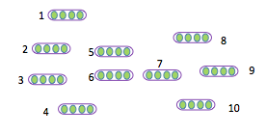

Learning Node Representations for Networks
Node Classification
Node Clustering
Link Prediction
Recommendation
…
Network
Node representations
E.g., Facebook social network -> user representations (features)-> friend recommendation
Text representation, e.g., word and document representation, …
degree
document
Deep learning has been attracting increasing
attention …
node
A future direction of deep learning is to integrate
unlabeled data …
network
text
word
Word representation
…
edge
The Skip-gram model is quite effective and efficient …
…
embedding
classification
Unstructured text
Word co-occurrence network
Notes:
My research focuses on learning node representations for networks. Given a large-scale network, the goal is to represent the nodes in low-dimensional spaces. Each node is represented with a low-dimensional vector, and the similarities between the nodes are preserved in the low-dimensional space. The node representations can be potentially useful in a variety of applications such as node classification and recommendation. Take the social network between users in Facebook as a concrete example. By learning the representations of the social network, each user will be represented as a low-dimensional vector, which can be used as features for the users. Then we can calculate the similarities between the users with the low-dimensional vectors. Based on the similarities, we can recommend similar users or friends to each user.
Since network is very general and flexible, learning node representations of networks can be applied to other applications as well. For example, we can construct the networks between words, the word co-occurrence networks, from unstructured text. By learning the representations of word co-occurrence networks, we are able to obtain word representations, which can be effective features for many natural language processing tasks.

Slide 13
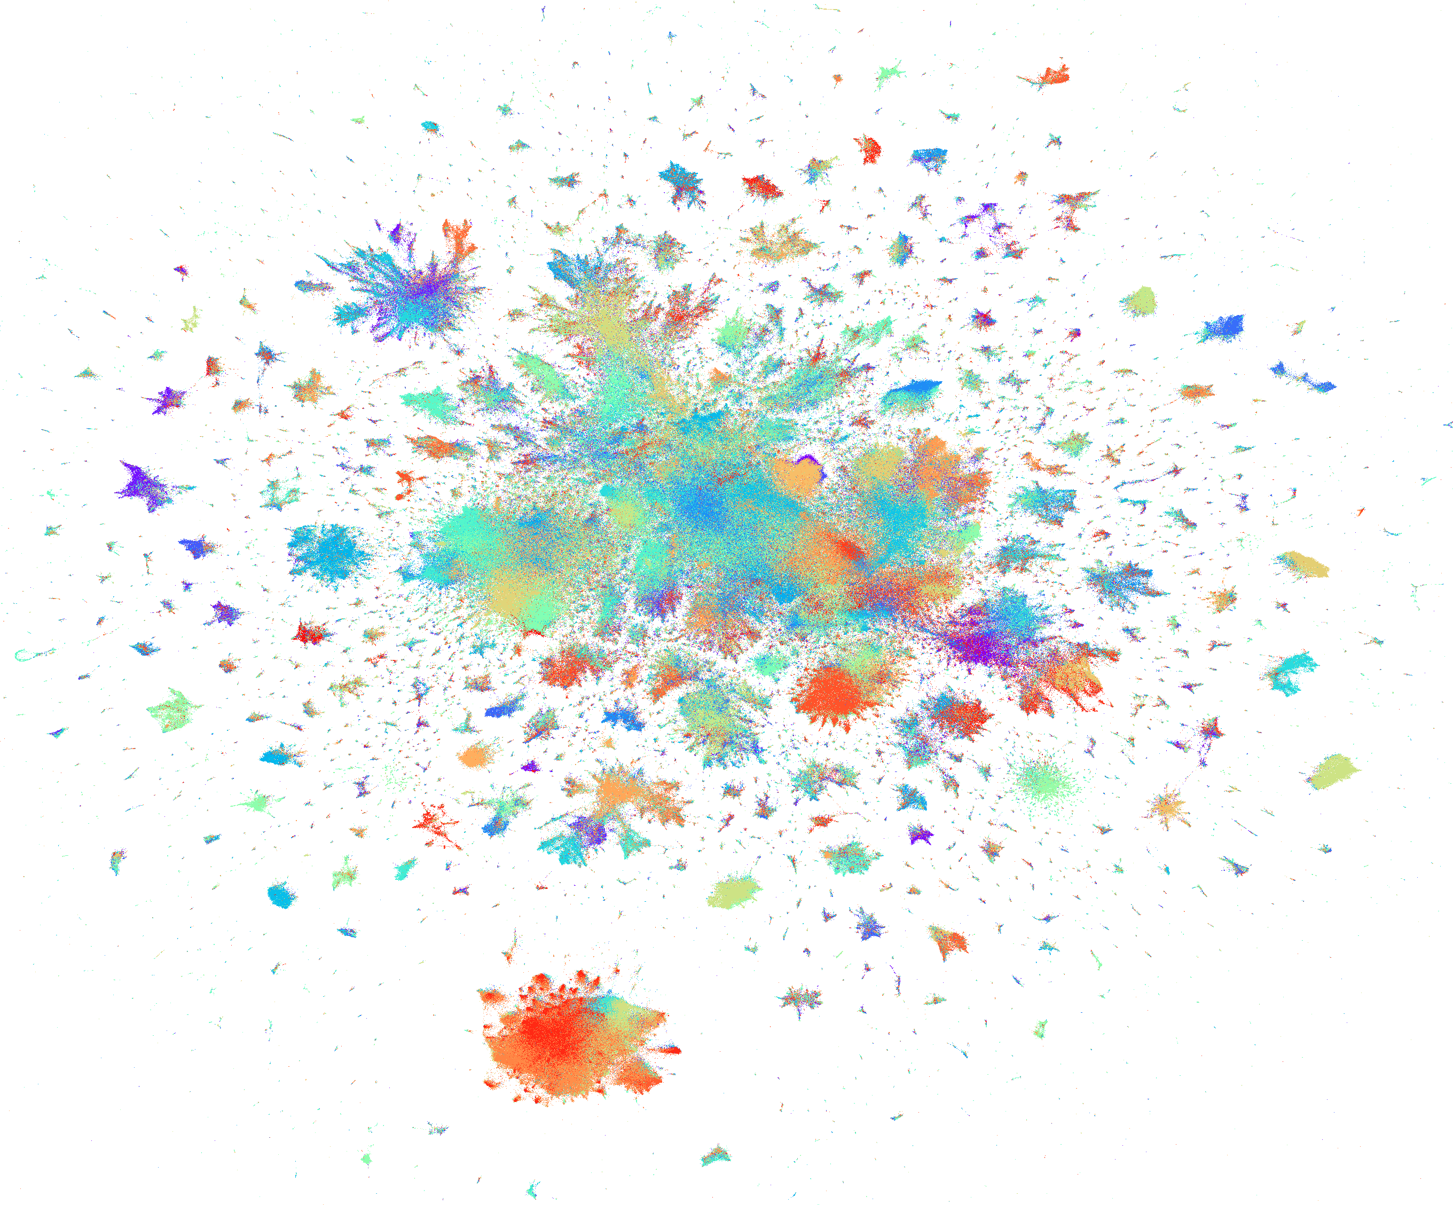
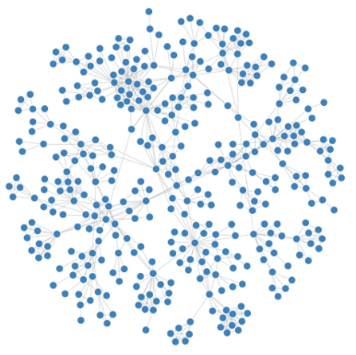
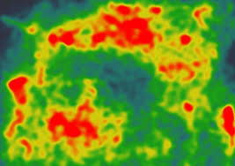
Extremely Low-dimensional Representations:
2D/3D for Visualizing Networks
….
….
….
….
….
….
….
High-dimensional Data
Networks
2D/3D Layout
Scatter Plots
Network Diagrams
Heatmaps
Notes:
When the dimensionality of the node representations becomes extremely small, for example, two or three dimensions, we are able to visualize the networks into two-dimensional or three-dimensional spaces. These low dimensional representations can be used for a variety of purposes. For example, they can be used as coordinates to build advanced visualizations to show the global characteristics of networks.
Again, since networks are very general and flexible. This can be generalized to visualize any high-dimensional data by first constructing networks from high-dimensional data, for example, K-nearest neighbor graph.

Slide 14
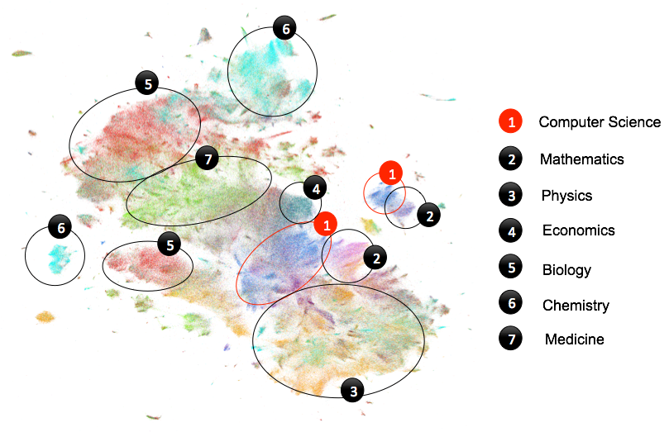
Visualizing Scientific Papers (Tang et al. 2016)
10M Scientific Papers on One Slide
Notes:
For example, this is a visualization of 10M scientific papers on one slide. Each data point is a paper, different colors corresponds to different subjects. We will come back to this visualization later.

Slide 15
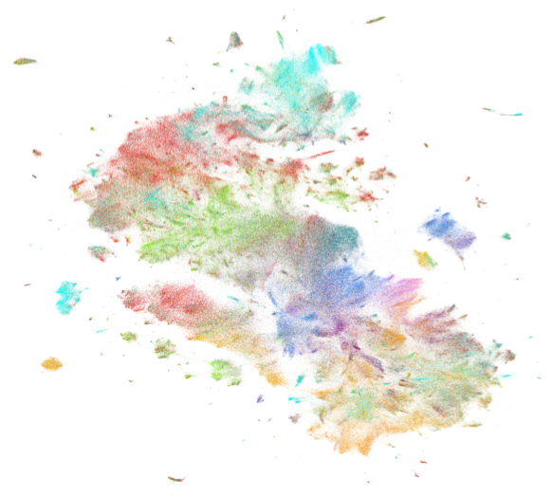

Roadmap
Learning Node Representations
for Networks
Visualizing Networks
Future Directions
Notes:
The rest of my talk is organized as follows. I will first talk about learning node representations for networks. Then I will introduce how to learn extremely low-dimensional-representations, 2D/3D representations for visualizing networks. Finally, I will discuss my future plans.

Slide 16
Roadmap
Learning Node Representations
for Networks
Visualizing Networks
Future Directions
Notes:
The rest of my talk is organized as follows. I will first talk about learning node representations for networks. Then I will introduce how to learn extremely low-dimensional-representations, 2D/3D representations for visualizing networks. Finally, I will discuss my future plans.

Slide 17
Node Embedding
Represent each node with a low-dimensional vector
  Preserve the similarities between the nodes in the low-dimensional space
Networks
Node representations
Notes:
Let me first define the problem of node embedding formally. Give a network or a graph G= (V, E, W), V is the set of nodes, E is the set of edges between the nodes, and W is the set of weights of the edges, the goal of node embedding is to represent each node with a low dimensional vector. In this low-dimensional space, the similarities of the nodes will be preserved. In other words, the structure of networks will be preserved.

Slide 18
LINE: Large-scale Information Network Embedding (Tang et al., Most Cited Paper of WWW 2015)
Arbitrary types of networks
Directed, undirected, and/or weighted
Clear objective function
Preserve the first-order and second-order proximity
Scalable
Asynchronous stochastic gradient descent
Millions of nodes and billions of edges: a coupe of hours on a single machine
Jian Tang, Meng Qu, Mingzhe Wang, Jun Yan, Ming Zhang and Qiaozhu Mei. LINE: Large-scale Information Network Embedding. WWW’15
Notes:
Inspired by the word2vec mode, we proposed a scalable model called LINE for learning node representations, which is applicable for various types of networks including directed, undirected and weighted. It has a clear objective function, which preserves the first and second-order proximity between the vertices. I’ll introduce the definition of the two proximity later. LINE is very scalable, which has a very effective and efficient optimization algorithm through asynchronous stochastic gradient descent. It only takes a couple of hours to learn the representation of networks with millions of nodes and billions of edges on a single machine.
Coming back to the objective of network representation? What is the right objective of network representation? Or in other words, what can we say about a good representation? It is natural to assume that under a good representation, the similarities of nodes should preserve the proximity of the nodes on the original network. Here, the proximity can be interpreted differently.

Slide 19
First-order Proximity
The local pairwise proximity between the nodes
However, many links between the nodes are not observed
Not sufficient for preserving the entire network structure
Notes:
One type of proximity is the first-order proximity, which is the local pairwise proximity and determined by the observed links. For vertices without links, their first-order proximity is 0. First-order proximity has been exploited by many existing graph embedding algorithms. However, many links between the vertices in real-world networks are not observed. Therefore, using first-order proximity is not sufficient for preserving the network structures. An alternative proximity must be provided.

Slide 20
Second-order Proximity
“The degree of overlap of two people’s friendship networks correlates
with the strength of ties between them” --Mark Granovetter
“You shall know a word by the company it keeps” --John Rupert Firth
Proximity between the neighborhood structures of the nodes
Notes:
Therefore, we introduce the second-order proximity between the vertices, which is the proximity between the neighborhood structures of the vertices. The intuition is that nodes sharing similar neighbors are likely to be similar to each other. For example, in a social network people who share many common friends are likely to share similar interest; Another example is that words that are used together with many similar words are likely to have similar meanings. Next I will introduce how to preserve the first-order and second-order proximity in the low-dimensional space.

Slide 21
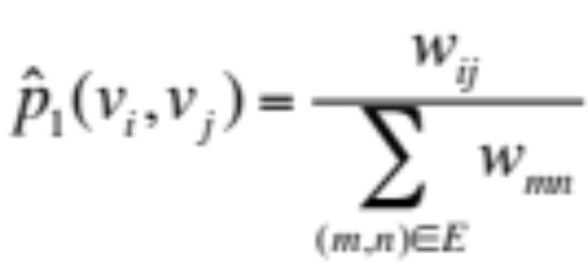
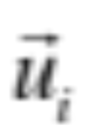
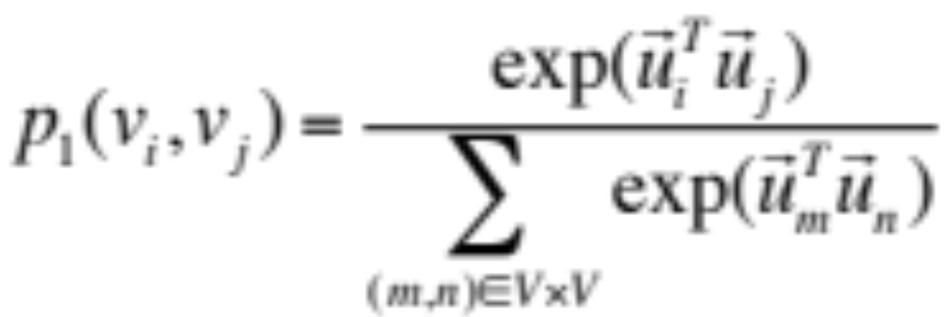
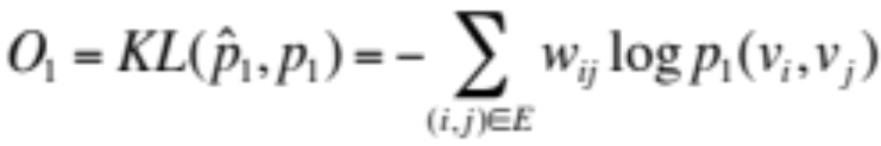
Preserving the First-order Proximity (LINE 1st)
Distributions: : (defined on the undirected edge i - j)
Empirical distribution of first-order proximity:
: Embedding of i
Model distribution of
first-order proximity:
Objective:
Notes:
I first define the empirical distribution of first-order proximity. For each pair of node i and j, the empirical distribution of first-order proximity between node i and j is defined as the weight of the edge between the two nodes and normalized by the weights of all the edges in the network. I also define a distribution of the first-order proximity based on the node representations using the softmax function. Here the vector u_i is the representation of node i. To preserve the first-order proximity, a straightforward way is to minimize the distance between the empirical distribution of the first-order proximity and the model distribution of the first-order proximity based on the node representations. For the distance between the distributions, we adopt the commonly used KL-divergence. The final objective function can be simplified as the negative log-likelihood of the observed undirected links.

Slide 22
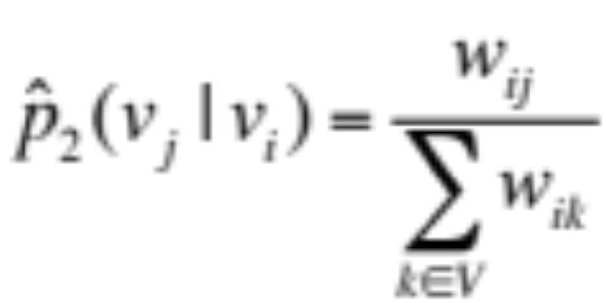
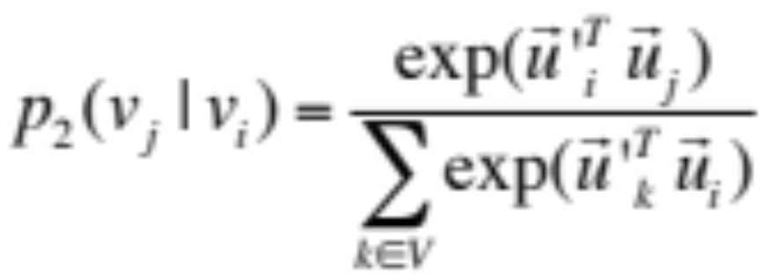
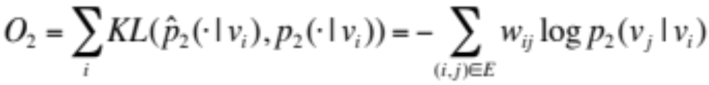
Preserving the Second-order Proximity (LINE 2nd)
Distributions: (defined on the directed edge i -> j)
Empirical distribution of neighborhood structure:
Model distribution of neighborhood structure:
Objective:
Notes:
As introduced previously, the second-order proximity between the nodes is determined by the proximity of their neighborhood structures. Therefore, we first define the neighborhood structures for each node . Empirically, for a node i, we define the probability from node i to its neighbor j as the weight of the edge between the two nodes w_ij and normalized by the weights of the edges in the neighborhood. Similarily, we can also define a distribution of the neighborhood structures based on node representations using a softmax function. Therefore, to preserve the second-order proximity, we only need to preserve the neighboorhood structures for all the vertices. KL-divergence is still used to measure the distance between the empirical distribution and model distribution of the neighborhood structure. The final objective can be simplified as the negative log-likelihood of the directed links.

Slide 23
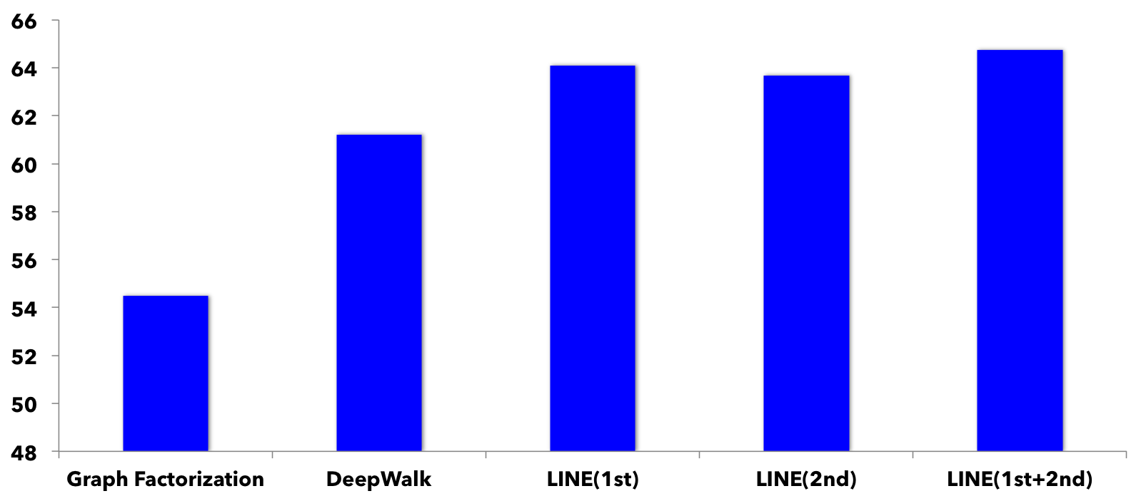
Application 1: Social Network Representation
(User Classification)
social network => user representations (features) => classifier
Community identities as classification labels
Accuracy
LINE(1st+2nd)>LINE(1st)>LINE(2nd )>DeepWalk>GF
Notes:
Now let’s look at some results on real-world data. We apply the LINE model to learn the node representations of social networks. By learning the representations of social networks, each user will be represented as a low-dimensional vectors. Then we evaluation the quality of the representations using the task of user classification, in which the communitiy identties are used as classification as lablels and the user represented are treated as features of the users.
These are the results on the Flick social network. We can see the LINE with first-order proximity outperforms LINE with second-order proximity. LINE with second-order proximity outperforms DeepWalk and Graph factorization. The combination of LINE with both first-order and second-order proximity yields the best performance.

Slide 24
Application 2: Unsupervised Text Representation
Construct text networks from unstructured text
degree
document
Text representation, e.g., word and document representation, …
node
network
word
text
Word co-occurrence network
Deep learning has been attracting increasing
attention …
edge
A future direction of deep learning is to integrate
unlabeled data …
embedding
classification
…
The Skip-gram model is quite effective and efficient …
Information networks encode the relationships
between the data objects …
text
doc_1
information
doc_2
Unstructured text
network
doc_3
Word-document network
word
doc_4
…
…
classification
…
Notes:
Besides applications on networks, learning node representations can be used for other applications by contucting networks from other data. For example,we apply the LINE model for learning unsupervised text representations. We first convert the unstructured text into different types of text networks . For example, the word co-occurrence networks, in which in each node is a word, and the weights of the edges between the words are the number of times the two words cooccur in all the local windows. Another network is the bi-partite network word-document network, in which the weights of the edges between a word and a document is the frequency of the word in the document. By representing the word co-occurrence network, we can obtain word representations. By representing word-document network, we can obtain both word and document representations.

Slide 25
Word Analogy
Entire Wikipedia articles => word co-occurrence network (~2M words, 1B edges)
Size of word co-occurrence networks does not grow linearly with data size
        Only the weights of edges change
Algorithm | Semantic(%) | Syntactic(%) | Overall
GF | 61.38 | 44.08 | 51.93
SkipGram | 69.14 | 57.94 | 63.02
LINE(1st) | 58.08 | 49.42 | 53.35
LINE(2nd ) | 73.79 | 59.72 | 66.10
LINE(2nd) > LINE(1st)
LINE(2nd) > SkipGram
Notes:
We learn the word representations by constructing word co-occurrence network from the entire Wikipedia articles, which contains around 2 million words and 1 billion edges. We evaluate the quality of the word representations with the task of word analogy, which is a typical task for word representation evaluation. Results show that LINE with second-order proximity outperforms LINE with first-order proximity. This is very reasonable since two word co-occur does not mean they are similar but two words cooccuring with many common words are more likely to be similar to each other. We are also superisingly to see that LINE with the second-order proximity outperforms the state-of-the-art word representations model Skipgram, which learns word representation directly from free text. The reason is that the word co-occurrence network contains the global structures of word coocurrences compared to unstructured free text. Another advantage of our approach is that the complexity of the algorithm does not grow linearly with data size since when the data increases, the size of word co-occurrence networks will not grow and only the weights of the edges between the words change.

Slide 26
Application 3: Semi-supervised Text Representation (Tang et al. 2015b)
Heterogeneous text network
  Word-word, word-document, and word-label networks
  Different levels of word co-occurrences: local context-level, document-level, label-level
Learning word embeddings through jointly training heterogeneous networks
Document embeddings as the average of word embeddings
Outperforms CNN on text classification (long documents)
null
Text representation, e.g., word and document representation, …
degree
text
doc_1
text
Deep learning has been attracting increasing …
document
information
doc_2
information
label_1
null
node
network
label_2
null
A future direction of deep learning is to integrate …
network
word
network
doc_3
…
text
word
doc_4
word
label_3
label
The Skip-gram model is quite effective and efficient …
edge
…
…
…
…
label
Information networks encode the relationships
…
classification
…
embedding
classification
classification
label
document
Word co-occurrence
network
Word-document
network
Word-label
network
Unstructured text
Jian Tang, Meng Qu, and Qiaozhu Mei. PTE: Predictive Text Embedding through Large-scale Heterogeneous Text Networks. KDD’15.
Notes:
For example, we proposed to study learn semi-supervised text representations with LINE. Besides constructing the word co-occurrence and word-document networks, which encode the unsupervised information, we also construct the word-label networks, which encode the supervised information. By jointly training the three networks, we can leverage both the unsupervised and supervised information. We calculate the document embeddings by simply taking the average of word embeddings.

Slide 27
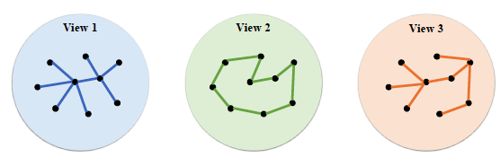
Multi-view Network Embedding
( Qu and Tang et al. CIKM2017)
  Multiple types of relationships between nodes exist in real-world networks
    E.g., following, retweeting relationships between users in Twitter
    Each type of relationship => a view of the network
    Multiple types of relationships => multi-view networks
  Infer robust node representations with multiple views
    Complementary information in different views
Figure: Networks with multiple views
Meng Qu, Jian Tang, Jingbo Shang, Xiang Ren, Ming Zhang, and Jiawei Han. Learning Distributed Node Representations
for Networks with Multiple Views. To appear in CIKM 2017.
Notes:
In real-world networks, there usually exist multiple types of relationships between nodes. For example, for users in Twitter, there exist following, retweeting relationships between users. Each type of relationship induces a view of the network and multiple types of relationships yields networks with multiple views. The information in different views are usually complementary to each other. Then the goal is how to learn a robust embedding for each node by leveraging information from multiple views.

Slide 28
Heterogeneous Star Network Embedding via Deep Reinforcement Learning
( Qu, Tang, and Han, WSDM 2018)
Heterogeneous Star Networks
Example 1: object: papers, attributes: (authors, conferences, titles)
Example 2: object: movies, attributes: (directors, actors, writers, keywords)
Training data
Different types of edges
Type of edges:a pair between the object
and a type of attribute
attribute 1
object
attribute 2
attribute 3
SGD for training
Sample from different types of edges
How to sample?

Slide 29
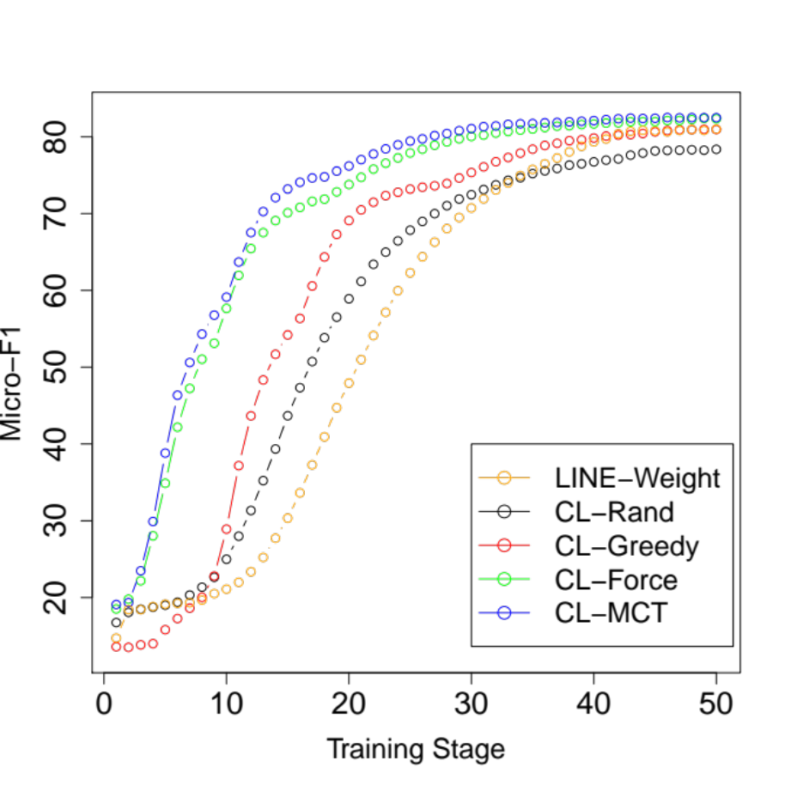
Learning the Curriculum via Deep Q-Network
Learning the optimal sequence of types of edges for training
Markov sequential decision process
      State: the sequences of edges of types
      Action: select the next type of edges,
      Reward: classification accuracy on
      validation data
Learning the state-action value
through the Deep Q-Network

Slide 30
Roadmap
Learning Node Representations
for Networks
Visualizing Networks
Future Directions
Notes:
The rest of my talk is organized as follows. I will first talk about learning node representations for networks. Then I will introduce how to learn extremely low-dimensional-representations, 2D/3D representations for visualizing networks. Finally, I will discuss my future plans.

Slide 31
Extremely Low-dimensional Representations:
2D/3D for Visualizing Networks
K-Nearest Neighbor Graph (KNN-G)
Construction
Graph Layout
….
….
….
….
….
….
High-dimensional Data
Networks
2D/3D Layout
Scatter Plots
Network Diagrams
Heatmaps
Notes:
Remember that the goal of node embedding in the first part is to learn effective feature representations for nodes, which are usually hundreds or thousands dimensions. The goal of network visualization is to learn extremely low-dimensional representations of nodes, for example, two or three dimensions so that we can visualize the networks in two or three dimensional spaces.
Since network is a very general data structure, we can use this to visualize any high-dimensional data by constructing a K-nearest neighbor graph from the data and then embed the K-NNG into two-dimensional space.
The two or three dimensions can be used for more advanced visualization techniques such as scatter plots, heatmaps and network diagrams, which help understand the networks and high-dimensional data.

Slide 32
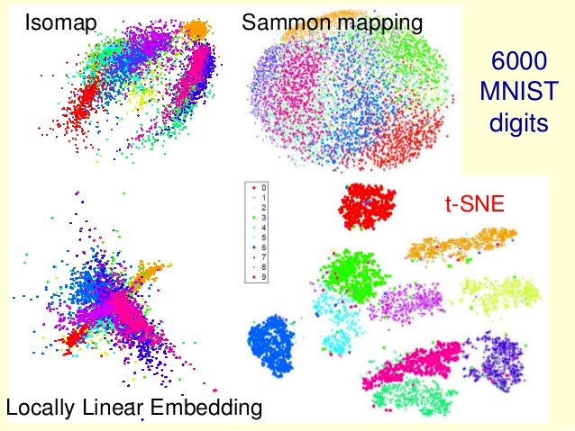
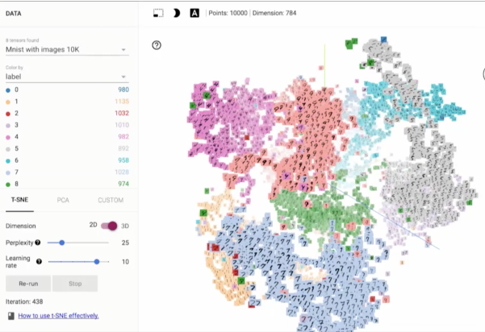
t-SNE (Maarten and Hinton, 2008, 2014 )
State-of-the-art algorithms for high-dimensional data visualization
Visualizations of MNIST Data
TensorBoard Visualizations by t-SNE
L.J.P. van der Maaten and G.E. Hinton. Visualizing High-Dimensional Data Using t-SNE. JMLR, 2008.
L.J.P. van der Maaten. Accelerating t-SNE using Tree-Based Algorithms. JMLR, 2014.
Notes:
In machine learning literature, the state-of-the-art approach for visualizing networks and high-dimensional data is t-SNE, which is proposed by Geoffrey Hinton and his post-doc Maarten. t-SNE has been used to visualize many different types of high-dimensional data. It is now used in Tensorflow for visualizing the representations learned by deep neural networks, which are usually hundreds or thousands dimensioons.

Slide 33
Limitations of t-SNE
K-NNG construction: complexity grows O(NlogN) to the number of data points N
Graph layout: complexity is O(NlogN)
Very sensitive parameters
Notes:
We can see that t-SNE has several limitations to scale up to very large data. In the stage of K-NNG construction and graph layout, the complexity w.r.t. the number of data point N is N log N, which can ber …
Besides, in practive, we found that parameters of t_SNE are very sensitve. And it is very time consuming to find an optmual paramter when the data becomes large …

Slide 34
LargeVis (Tang et al., Best Paper Nomination at WWW 2016)
Efficient approximation of K-NNG construction
30 times faster than t-SNE (3 million data points)
Better time-accuracy tradeoff
Efficient probabilistic model for graph layout
O(NlogN) -> O(N)
7 times faster than t-SNE (3 million data points)
Better visualization layouts
Stable parameters across different data sets
Jian Tang, Jingzhou Liu, Ming Zhang, and Qiaozhu Mei. Visualizing Large-scale and High-dimensional Data. WWW’16
Notes:
We propose a new visualization technique called LargeVis for visualizing large-scale and high-dimensional data. It enjoys a very efficient approach for K-nearest neighbor graph construction, which is thirty times faster than t-SNE on three million data points. It also has a better time-accuracy tradeoff. LargeVis has a very efficient approach for graph visualization, the complexity of which is linear to the number of data points. On three million data points, it is seven times faster than t-SNE. The visualizations generated by LargeVis are also more effective. Besides, the parameters of LargeVis are very stable across different sets.

Slide 35
10M Scientific Papers on One Slide
Notes:
Visualizing high-dimensional data is very important because the visualization is able to intuitively show the global structure of the data, helping us answer many questions that would not be possible without the visualization. For example, if I ask you a question “where do you think computer science locates in the map of all sciences?” You may have no idea. We can answer this question with a visualization – a visualization that maps 10 million scientific papers in one slide. Every data point is a paper, and papers from the same domains form clusters. Every color represents a field. Where is computer science? Over here, pretty central, which is great. It is close to mathematics, physics, and economics. Beside them we can also see big clusters that correspond to biology, chemistry, and medicine, which are close to each other.

Slide 36
10M Scientific Papers on One Slide

Slide 37
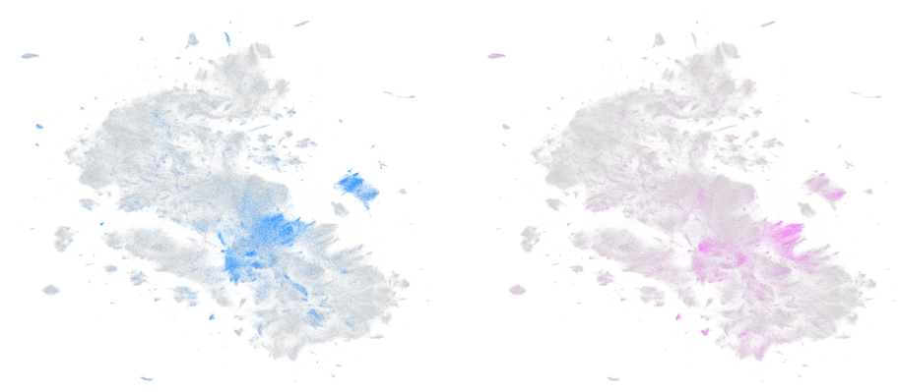
Computer Science
Mathematics
Notes:
We can also take a closer look and compare two fields. Here we compare the papers in computer science and mathematics. We can see that the layouts of their papers do overlap quite a bit, showing that computer science and mathematics are indeed very related to each other.

Slide 38
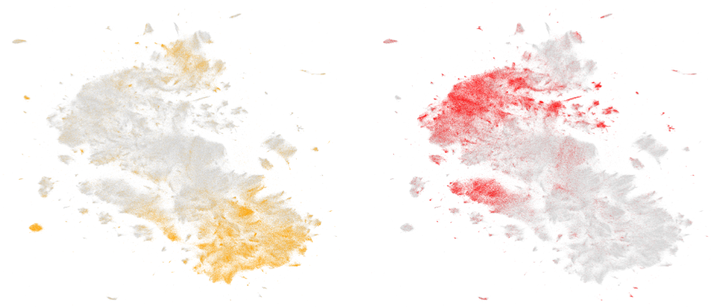
Physics
Biology
Notes:
Similarly, we can compare physics and biology. This time the two fields do not overlap much.

Slide 39
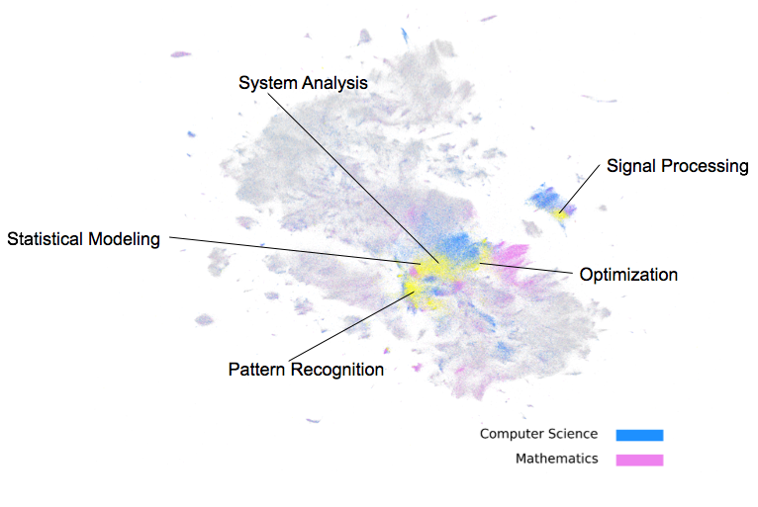
Computer Science vs. Mathematics
Notes:
Coming back to computer science and mathematics. By coloring the overlapped regions differently with the yellow color, we can observe the common topics of the two fields We can see that the most common topics of the two fields are statistical modeling, pattern recognition, optimization, signal processing and system analysis. This is very reasonable, as mathematics provides computer sciences the fundamental theory and analysis tools.

Slide 40
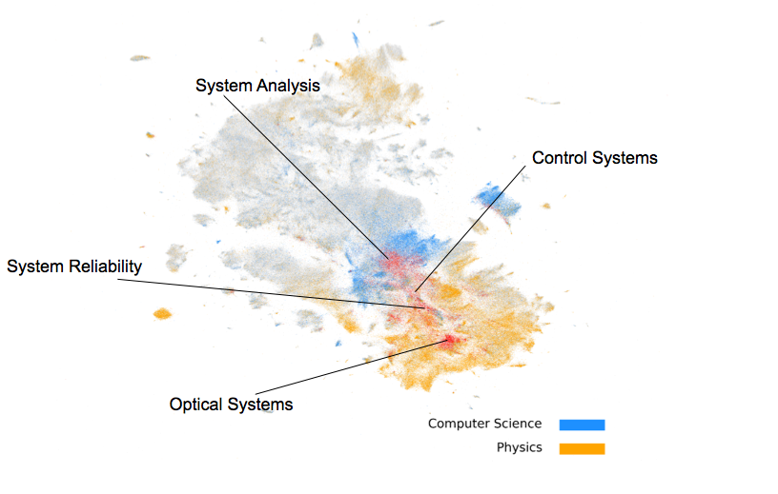
Computer Science vs. Physics
Notes:
What about the overlap between computer science and physics? The common topics between computer science and physics, colored in red, are system reliability, optical systems, control systems and system analysis. You can see all of them are about systems. Note that the topic “system analysis” is shared by all the three fields.

Slide 41
Software
Our release:
LINE:
(C++)
https://github.com/tangjianpku/LINE
(307 stars, released since 2015.3)
LargeVis :
(C++&Python)
https://github.com/lferry007/LargeVis
(307 stars, released since 2016.7)
Other tools based on our implementation:
R version in CRAN:
https://github.com/elbamos/largeVis
LargeVis Tutorial:
https://jlorince.github.io/viz-tutorial/
Interactive Visualization:
https://github.com/NLeSC/DiVE
…
Notes:
Both the source codes of LINE and LargeVis are released and received a lot of attention. There are also many other open source implementations or tools based on our release. To name a few, there is an R implementation of LargeVis released in the official repository of CRAN. There is a python tutorial on how to visualize high-dimensional data with LargeVis from scratch. There is a interactive visualization tool to explore high-dimensional data based on LargeVis. LargeVis can be particularly useful in understanding deep neural networks by visualizing the representations learned by neural networks.

Slide 42
Roadmap
Learning Node Representations
for Networks
Visualizing Networks
Future Directions
Notes:
The rest of my talk is organized as follows. I will first talk about learning node representations for networks. Then I will introduce how to learn extremely low-dimensional-representations, 2D/3D representations for visualizing networks. Finally, I will discuss my future plans.

Slide 43
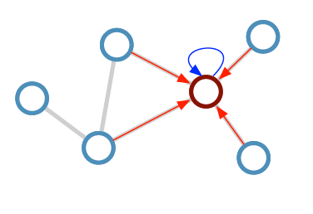
From Unsupervised Node Embeddings to
Task-specific Embeddings
Most existing approaches of node embeddings are unsupervised
  Preserve network structures
Node embeddings for specific tasks
  E.g., node classification
Semi-supervised graph classification via Graph Convolutional Neural Netorks (GCNN, Kipf et al. 2017)
  Neural message passing
Thomas N.Kipf and Max Welling. Semi-Supervised Classification with Graph Convolutional Networks. ICLR’17.
Notes:
Another work by Kipf studied learning semi-supervised node embeddings with graph convolutional neural networks. In this work, each node is associated with a D-dimensional feature vector. Some labels of the nodes are given and the goal is to classify the rest of the unlabeled nodes.
In this work, a multi-layer graph convolutional network is proposed to learn the node embeddings, which essentially update the node embeddings by combining the embeddings of the node itself and the embeddings of its neighbors.

Slide 44
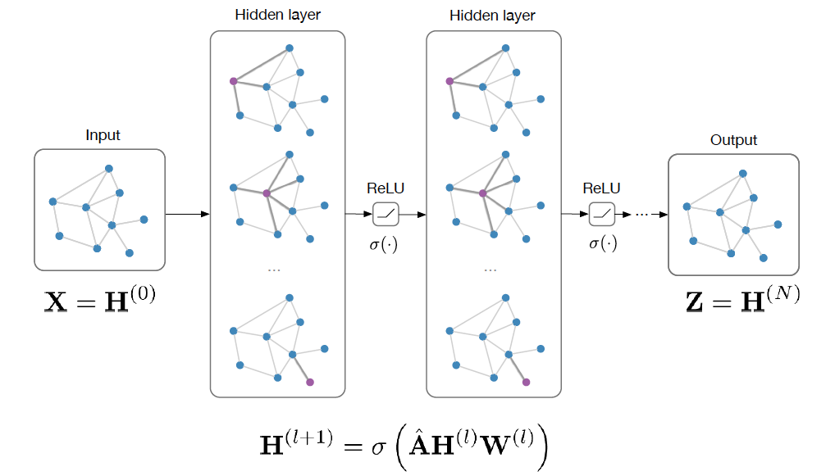




Multi-layer Graph Convolution Neural Networks
Final objective:
Starting from the node features
Define the propagation rule
Add the self-links
=
Normalize the matrix
Nonlinear propagation
Notes:
More specifically, the intitial node embedding is set as the node features. Then one layer of graph convolutional neural network is applied to the node embeddings of previous layer, which will update of the node embeddings.
We can take a closer look at the graph convolutional neural networks. The adjancy matrix is first added to the identity matrix, which essentially adds the self-links, and then normalized. Multiplying the normalized matrix with node embeddings of previous layer Hl, followed up by a non-linear transformation. By doing this, we can update the node embeddings.
The node embeddings of final layers are used to for classification and the whole network is trained by backprogation.

Slide 45
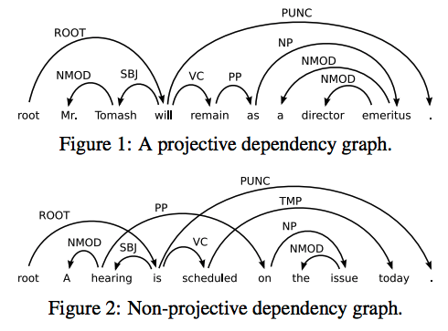
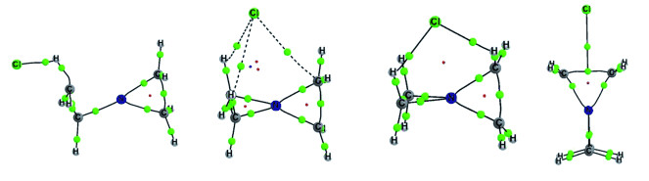
From Node Embeddings to
Network Embeddings
A collection of small networks with different structures
Sentence dependency graph
Molecule networks
…
Ego-networks
Notes:
So far we have talked about how can we learn representations for nodes, which are good for tasks like Node classification, Recommendation, Link prediction.
There are some other tasks that are hard for node embedding methods to handle, like Information cascades, Community detection, Protein function prediction.
This is where we want to go beyond node representations, and learn a representation of the entire graph.

Slide 46
Challenges for Node Embeddings
Scalability
  How to scale up to networks with billions of nodes
Hierarchical representations
  How to learn hierarchical representations of networks
Dynamic
Heterogeneous networks
  Multiple types of nodes, multiple types of edges
…
Notes:
Looking forward, learning network representation is still a very new and promising direction to explore. There still exists many challenges for network representation learning. One challenging is how to scale up to very large networks, for example, networks with billions of nodes. Most of existing work is able to scale up to networks with tens of millions of nodes on a single machine. How to scale up to billions of nodes with multiple machines remains unexplored.
Another direction is how can we learn hierachical representations of networks. Existing node representations are usually flat. However, some properties of networks such as communities are essentilly a hierarchical structure. Therefore, in the future, it would be very interesting if we can learn hiearchical representations of networks.
Real-world networks are dynamic and heterogenous, how can we learn the representations of such kind of networks.
Finally, how to effective learn ismorphism-invariance representations of networks remains to be very challening. In other words, if two networsk are ismorphis, we should able to learn similar representations from them. This is still a very challenging problem.

Slide 47
Challenges for Network Embeddings
The structures of different networks are different
Notes:
Therefore, the research question I try to answer is: how to effectively and efficiently learn the representation of networks?
This is a very challenging problem since real-world networks are very large-scale, which usually contain millions of nodes and billions of edges or even beyond this. Besides, Real-world networks are also heterogeneous. The edges of networks can be directed, undirected, binary, or, weighted.
In machine learning literature, although there are many work study learning representations of images, speeches or natural languages, there is little work on learning representations of networks.

Slide 48
Take Away
Network representation: a new methodology for analyzing and mining networks
Learning node representations: LINE
Visualizing networks and high-dimensional data: LargeVis
Future:
  From unsupervised to task-specific node embeddings
  From node to network embeddings
Notes:
To summarize, we can see that learning representations of networks has become a new methodology for analyzing and mining networks. Existing state-of-the-art appraoches for node representation learning inculding LINE, DeepWalk and Node2VEC has achieve great success in a variety of tasks, and now it is moving towards learning task-specific node represenations such as the PTE and Graph convolution model.
For visualizing networks and high-dimensional data, LargeVis has become the new state-of-the-art appraoch, which makes it feasible to visualzie tens of millions of nodes or data points.
Beside learning node representations, there are also increasing interest in learning representations of network substrutures such as applications in information cascades and protein function prediction.

